Slide 1
Geoduck as indicators of environmental change
Exploring CHANGES IN PROTEOMIC SIGNALS BETWEEN SITES
LAURA H SPENCER
MASTERS CANDIDATE
SCHOOL OF AQUATIC & FISHERY SCIENCES
UNIVERSITY OF WASHINGTON

Slide 2
PROJECT QUESTIONS
Can we develop assays of environmental stress in geoduck using proteomics?
Which proteins of interest can we clearly detect?
Can we detect differences in protein composition between habitats, sites?

Slide 3
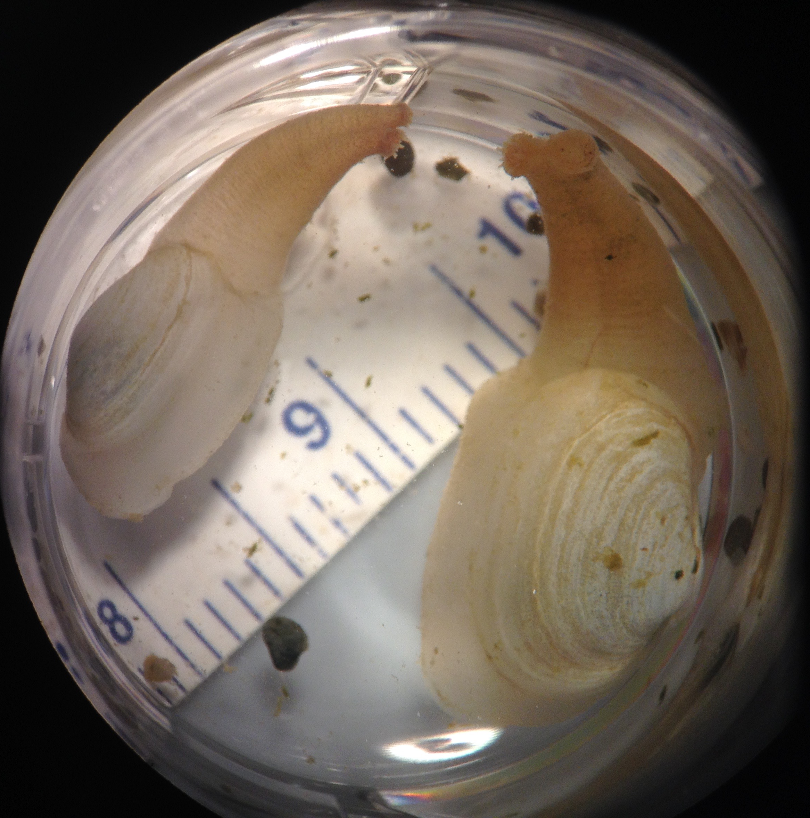
THE GEODUCK Panopea generosa
Native to WA
Largest burrowing clam in the world
Wild stock landings (2015): 4.936M lb, $41M (WDFW)
Highly valuable aquaculture species with growing industry; 27% shellfish aquaculture revenue (2013)
This study: sibling juvenile geoduck seed provided by Taylor Shellfish hatchery

Slide 4
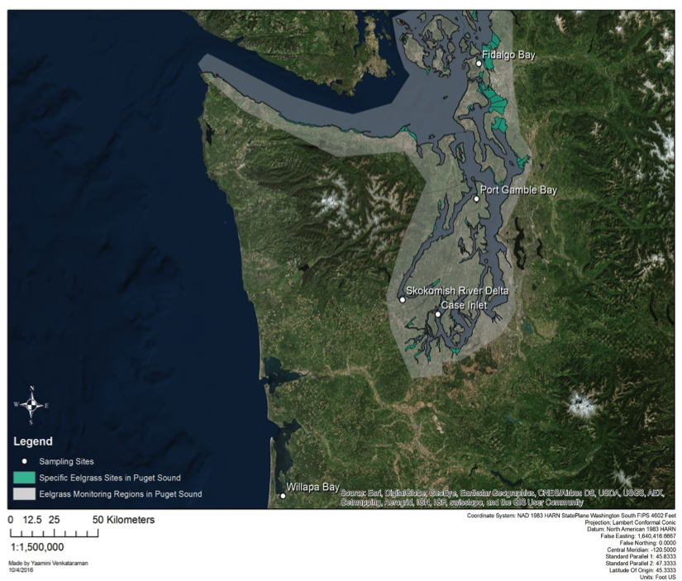
5 SITES Puget Sound & Willapa Bay
Fidalgo Bay
Port Gamble Bay
Skokomish
River Delta
Case Inlet
Willapa Bay

Slide 5
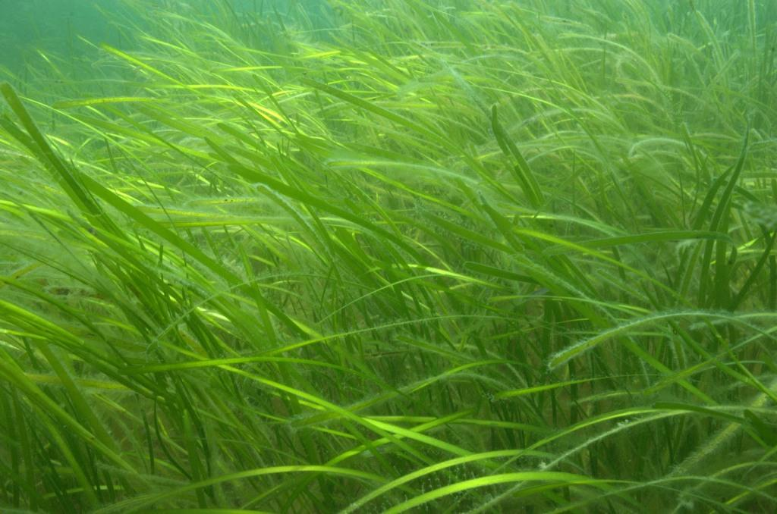
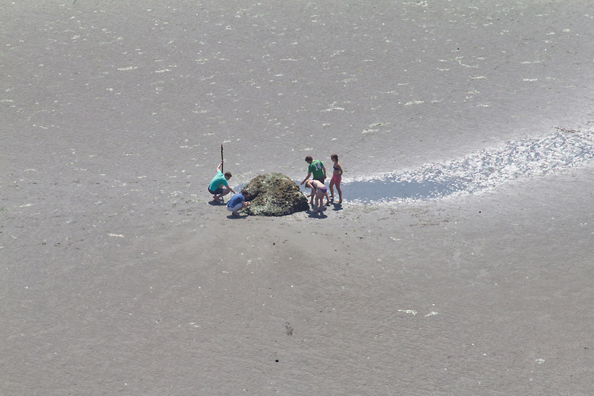
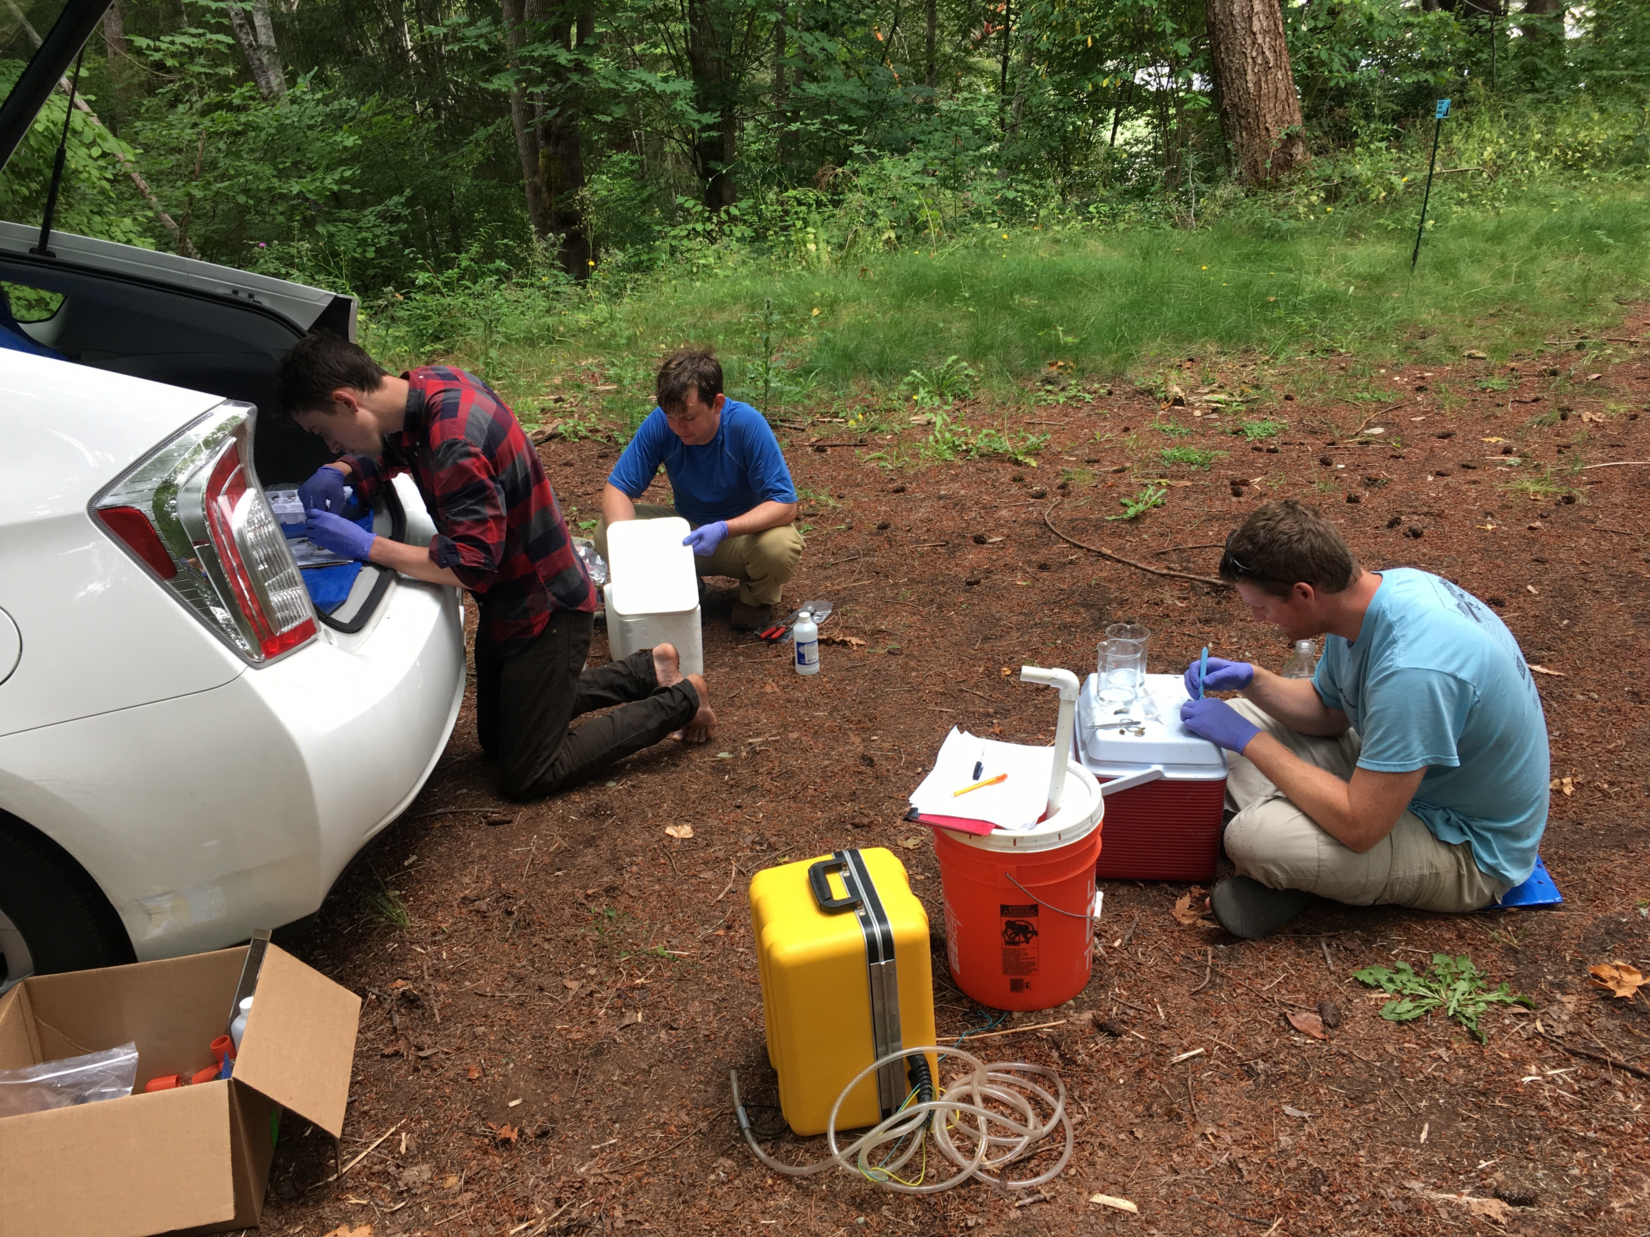
EXPERIMENTAL OUT-PLANT
1 month (June, August)
n=20 in 4 PVC enclosures per location
Durafet, Seabird CTD for pH, temperature, salinity, depth, chlorophyll
Measured growth, dissected and sampled ctenidia, frozen on site.
Extracted proteins, digested & isolated peptides via Mini-Trypsin digestion
PROBES
PROBES
EELGRASS BED
BARE SEDIMENT

Slide 6
Protein analysis in 2-phases
PHASE I
DATA INDEPENDENT ANALYSIS
(DIA)
PHASE II
SELECTED REACTION MONITORING (SRM)
Orbitrap Fusion Lumos machine
No pre-selected precursor ions needed
Captures all peptides within designated mass/charge ratio (m/z)
TSQ Vantage machine
Requires pre-selected list of transitions (m/z, retention time)
Captures precise & sensitive quantitative data
Identify & quantify peptides via
MS/MS
PECAN
Survey peptides against annotated background proteome
Generate summary file for direct use in Skyline
PRTC, internal peptide standard
Regress RT from SRM against DIA to confirm peptide identities
Also perform dilution curve with known protein concentrations
Identify proteins in samples & quantify
Skyline
Visualize results, check peak selection error rate
Identify peptides with strong signals
Skyline
Quality control all peak selections
Remove poor-quality peaks
Quality Control
Normalize abundance via standard
Assess technical rep quality
Assess dissimilarity via NMDS
ANOSIM for site/treatment similarities
Annotate proteins with GO
Assess differential expression (NMDS)
Identify interesting proteins with strong clear signals
DATA ANALYSIS

Slide 7
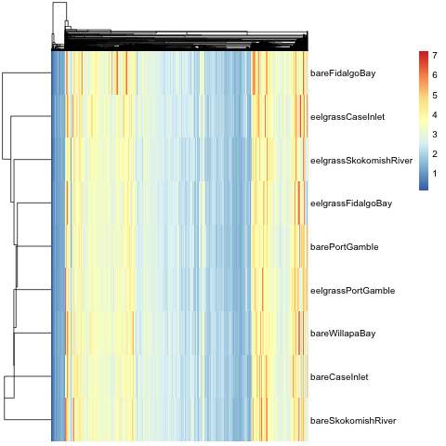
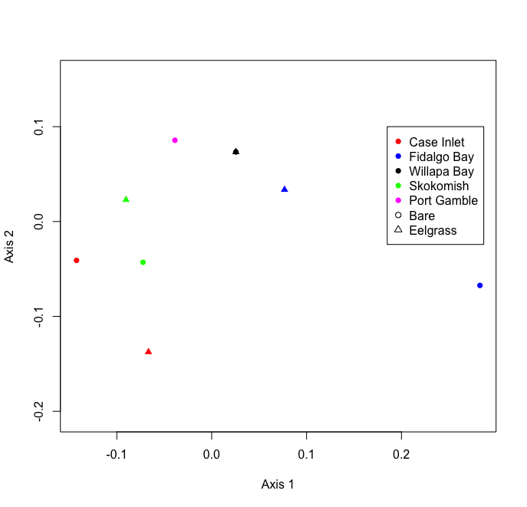
Phase I Shotgun Proteomics Results
10 samples analyzed, 1 per site/treatment
8,076 proteins, 5,690 annotated
Clustering by site more than treatment

Slide 8
Proteins selected for Phase 2
PROTEIN | Response to… | Uniprot ID
Heat Shock Protein 90-alpha | Stress | P30946
Heat Shock Protein 70 | Stress | Q91233
Superoxide Dismutase | Oxidative stress | P28757
Catalase | Oxidative stress | P00432
Peroxiredoxin-1 | Oxidative stress | Q6B4U9
Puromycin-sensitive aminopeptidase | Oxidative stress | Q11011
Protein disulfide-isomerase | Oxidative stress | P07237
Ras-related protein Rab-11B | Acidic pH | O35509
Sodium/Potassium-transporting ATPase subunit alpha | pH changes | Q13733
Cytochrome P450 | Toxins | P00185
Arachidonate 5-lipoxygenase | Inflammation | P09917
Glycogen Phosphorylase (muscle form) | Carbohydrate metabolism | Q9WUB3
Trifunctional enzyme subunit beta (mitochondrial) | Lipid metabolism | O46629

Slide 9
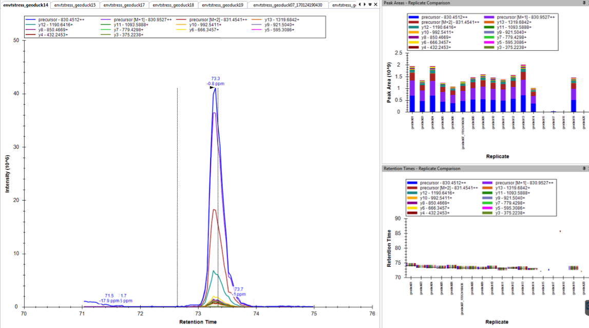
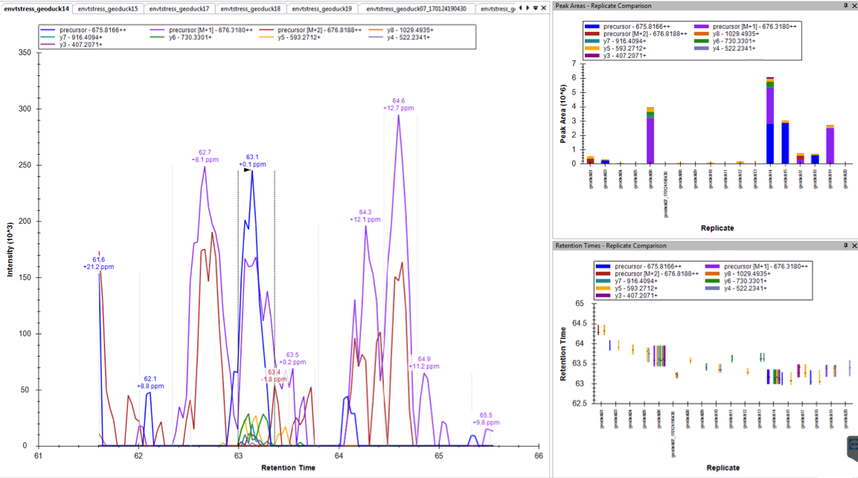
Selected proteins have strong, clear signal
gigasin
Poor quality
Good quality
Heat Shock Protein 70

Slide 10
Protein analysis in 2-phases
PHASE I
DATA INDEPENDENT ANALYSIS
(DIA)
PHASE II
SELECTED REACTION MONITORING (SRM)
Orbitrap Fusion Lumos machine
No pre-selected precursor ions needed
Captures all peptides within designated mass/charge ratio (m/z)
TSQ Vantage machine
Requires pre-selected list of transitions (m/z, retention time)
Captures precise & sensitive quantitative data
Identify & quantify peptides via
MS/MS
PECAN
Survey peptides against annotated background proteome
Generate summary file for direct use in Skyline
PRTC, internal peptide standard
Regress RT from SRM against DIA to confirm peptide identities
Also perform dilution curve with known protein concentrations
Identify proteins in samples & quantify
Skyline
Visualize results, check peak selection error rate
Identify peptides with strong signals
Skyline
Quality control all peak selections
Remove poor-quality peaks
Quality Control
Normalize abundance via standard
Assess technical rep quality
Assess dissimilarity via NMDS
ANOSIM for site/treatment similarities
Annotate proteins with GO
Assess differential expression (NMDS)
Identify interesting proteins with strong clear signals
DATA ANALYSIS

Slide 11
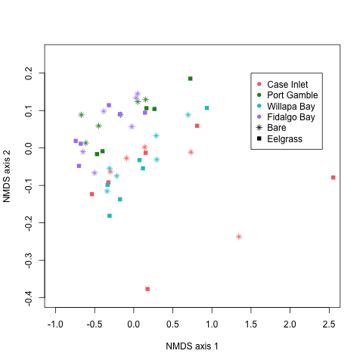
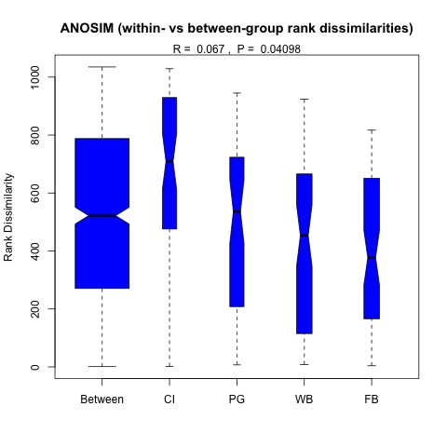
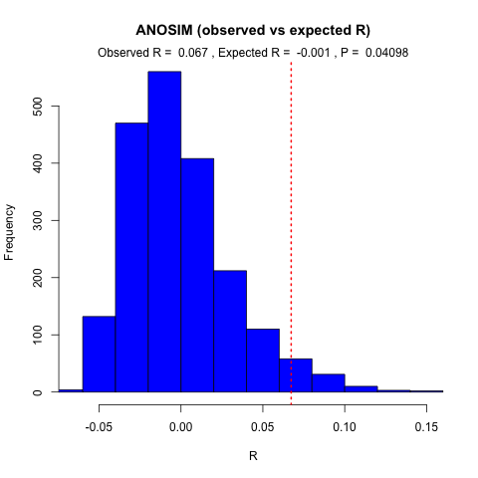
SRM Results Site Differences

Slide 12
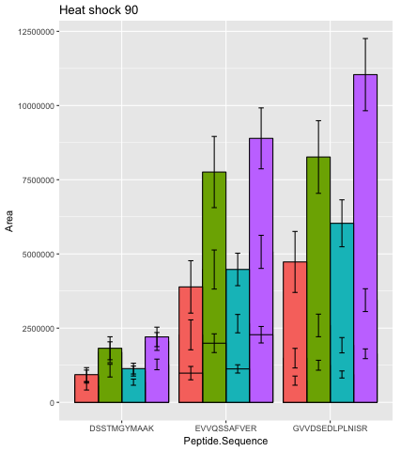
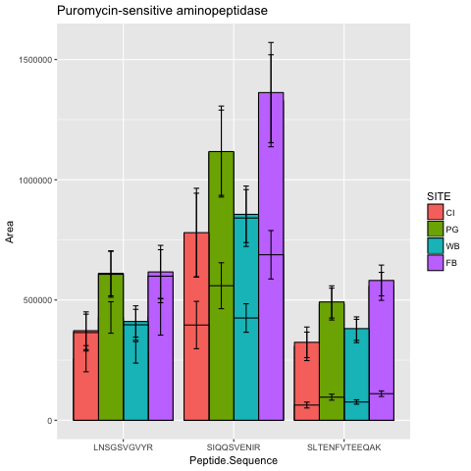
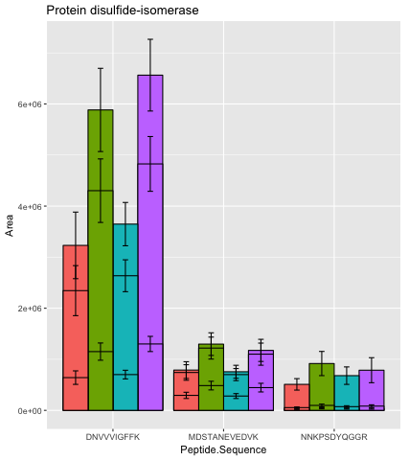
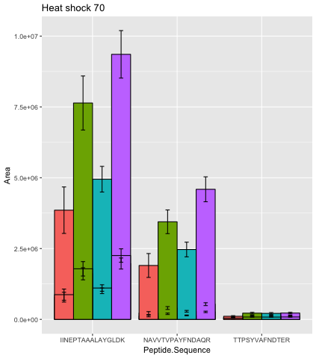
Stress & re-folding proteins mean peptide abundance by site

Slide 13
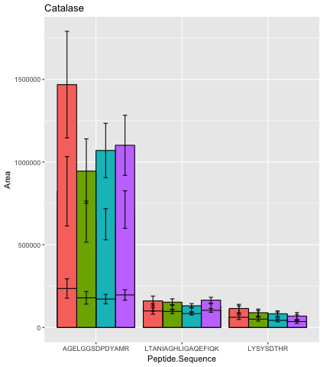
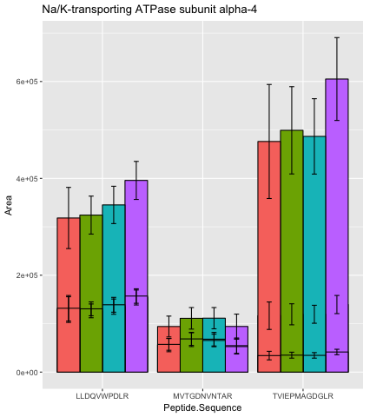
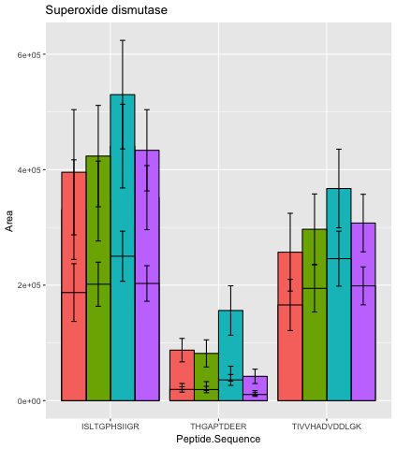
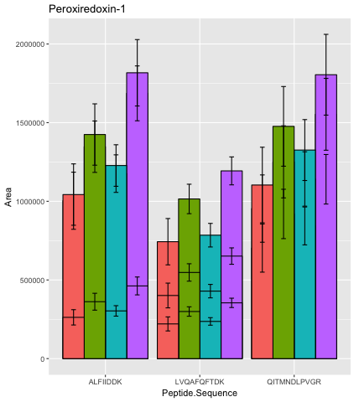
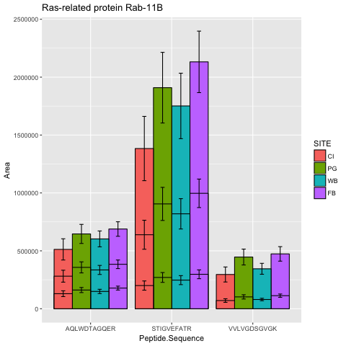
pH & reactive oxygen species (ROS) regulation proteins mean peptide abundance by site
Oxidative stress
pH changes
Oxidative stress
Acidic pH
Hmmmm…. From Micah: Port Gamble Bay: most corrosive, Fidalgo Bay: best carbonate chemistry

Slide 14
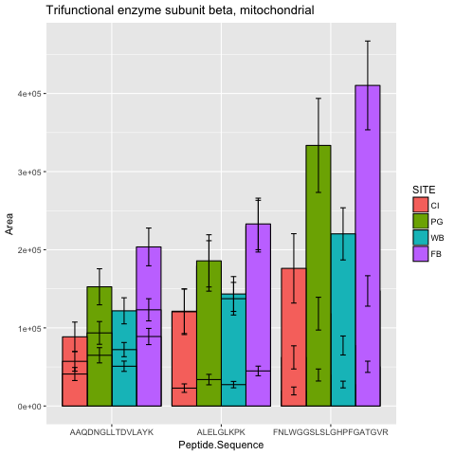
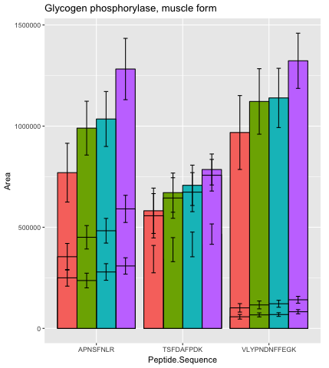
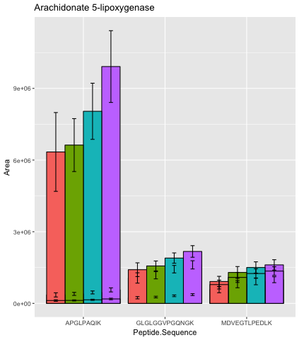
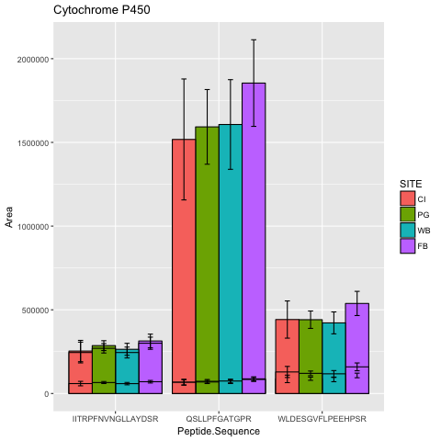
Other monitored proteins mean peptide abundance by site
Lipid
metabolism
Carbohydrate metabolism
Toxins
Inflammation

Slide 15
Conclusions & Next Steps
No observed differences between eelgrass and bare sediment in geoduck gill tissue
Site differences, particularly North Sound vs. South & Willapa Bay
Clear pattern of up-regulated stress proteins in Fidalgo Bay, Port Gamble Bay
Overlay with environmental data
Assess proteins for use as assay
Figure out: cost per sample for mass spec
Diff in env clearly impacting physioloigcal response

